Slide 1
Middle Woodland Interaction in the American Bottom:
Ceramic Analysis at the Gehring Site
Ashley Cisneros

Slide 2
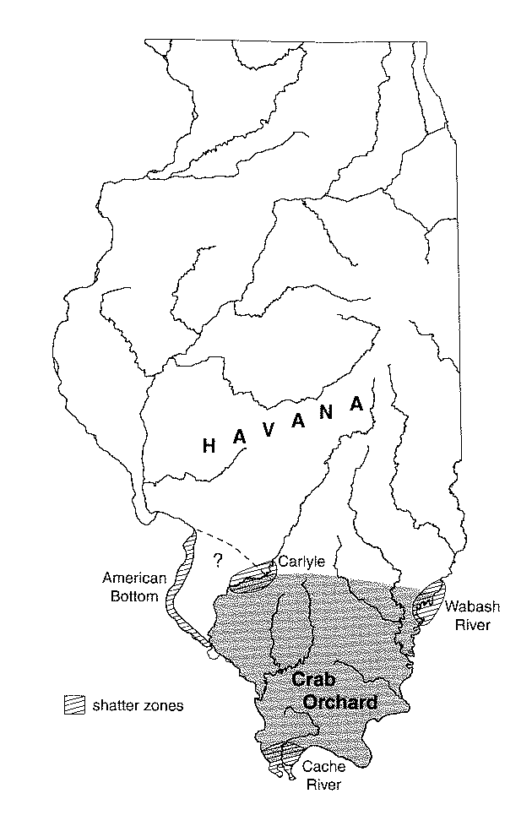
Introduction
American Bottom during
the Middle Woodland Period
(BC 150- AD 350)
  Possible “Shatter Zone”?
    Struever 1964
  Fortier (2006) points to
  migration from north
  Possible trade with South?
  How can migration be
  distinguished from trade?
Fortier 2006

Slide 3
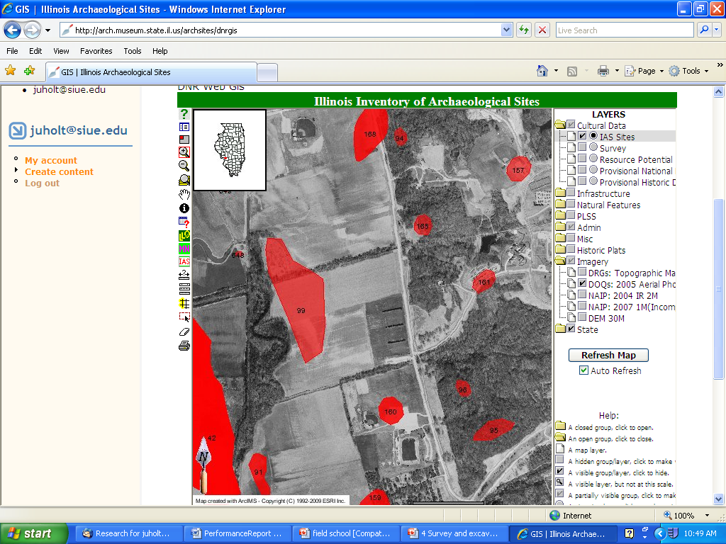
Gehring Site

Slide 4
Hypotheses
  The ceramic assemblage of the Gehring site Feature 102 will be similar to that of the Havana Tradition
  Due to its location in the upper American Bottom, the Gehring Site will have few Southern Tradition ceramics
  The ceramic assemblage will point to a mixture of trade and migration.

Slide 5
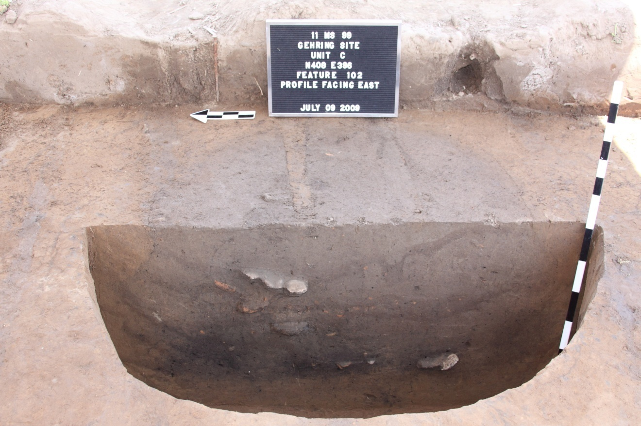
Methods and Analysis
Excavation of
Feature 102
Ceramic analysis
  Surface treatments
  Temper types
  Wall thickness and
  rim diameter

Slide 6
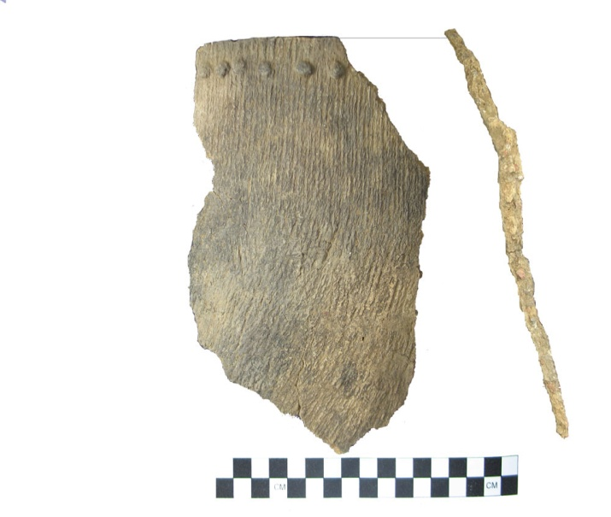
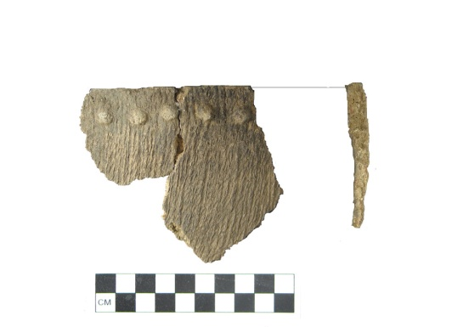
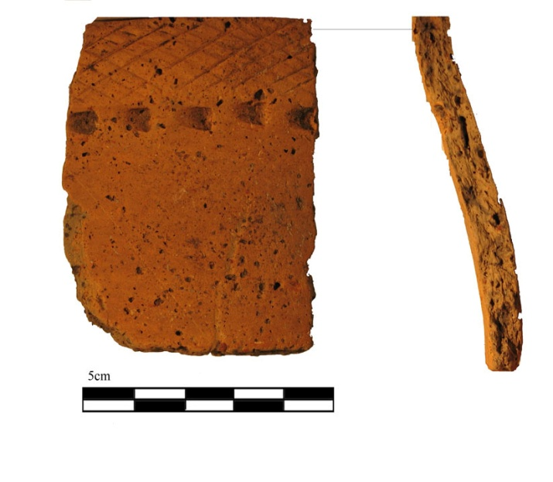
Results
Most common
  Havana Cordmarked
  Hopewell Crosshatch
MNV=8
Types of ceramics
  Havana Plain
  Havana Cordmarked
  Hopewell Crosshatch
  Hopewell Zoned
  Stamped
  Holding Cordmarked
  Pike Rocker Stamped
  Montezuma Punctate

Slide 7
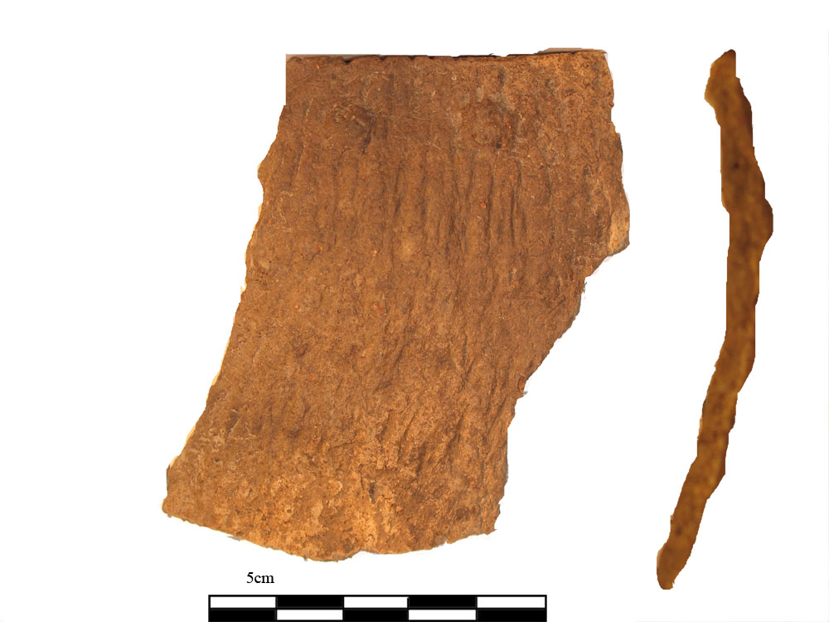
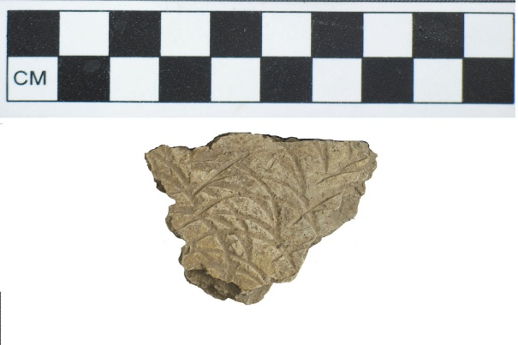
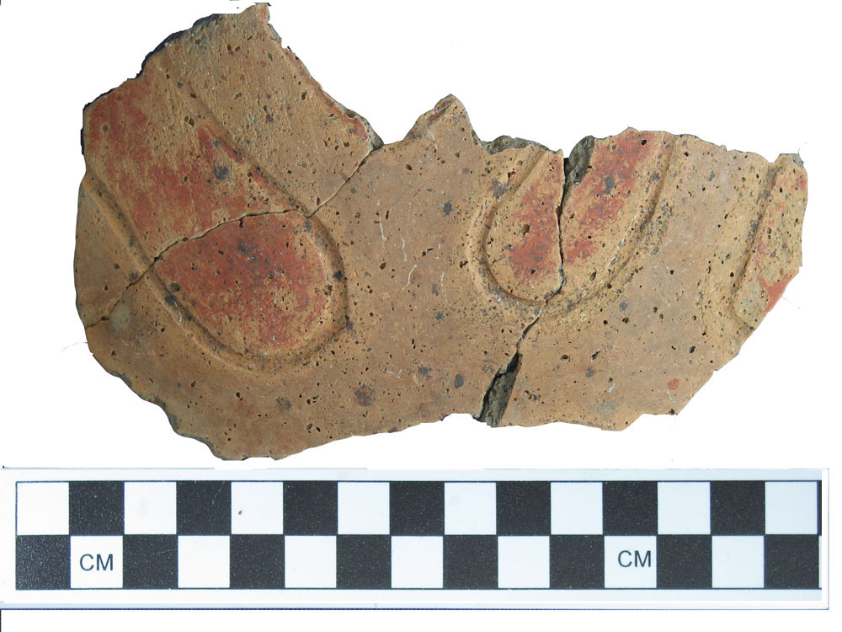
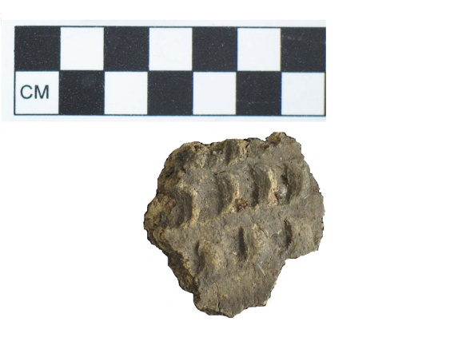
Results (cntd)
Holding ceramic
    Holding Cordmarked
Time period
  (Holding Phase AD 50-AD 150)
Equifinality

Slide 8
Concerns
Holding/Havana conundrum
Confusing Typology
No clear reasons as to why some archaeologists choose migration over trade as an explanation

Slide 9
Conclusion
Gehring site ceramic assemblage is indeed similar to that of the Havana Tradition
No Southern Tradition ceramics in Feature 102 or site during 2009 Field School
Both trade and migration are feasible as explanations
Relationship between Holding/ Havana ceramics remains unclear
More research needed

Slide 10
References
Fortier, A.C.
  1989 Site Interpretation. In The Holding Site (11-Ms-118): A Hopewell Community in the American Bottom, by Andrew C. Fortier, Thomas O. Maher, Joyce A. Williams, Michael C. Meinkoth, Kathryn E. Parker, and Lucretia S. Kelly, pp. 555-583. American Bottom Archaeology FAI-270 Site Reports Vol. 19. University of Illinois Press, Urbana
  2006 The Land between Two Traditions: Middle Woodland Societies of the American Bottom. In Recreating Hopewell, edited by D. K. Charles and J. E. Buikstra, pp. 328-338. University Press of Florida, Gainesville.
Griffin, James B.
  1952 Some Early and Middle Woodland Pottery Types in Illinois. In Hopewellian Communities in Illinois, edited by Thorne Deuel, pp 83-129. Illinois State Museum, Scientific Papers 5.
Maher, Thomas O.
    1989 The Middle Woodland Ceramic Assemblage. In The Holding Site (11-Ms-118): A Hopewell Community in the American Bottom, by Andrew C. Fortier, Thomas O. Maher, Joyce A. Williams, Michael C. Meinkoth, Kathryn E. Parker, and Lucretia S. Kelly, pp. 125-318. American Bottom Archaeology FAI-270 Site Reports Vol. 19. Unive rsity of Illinois Press, Urbana.
Morgan, David T.
  1985 Ceramic Analysis. In Smiling Dan: Structure and Function at a Middle Woodland Settlement in the Illinois Valley, edited by Barbara D. Stafford and Mark B Sant, pp. 183-257. Kampsville Archaeological Center, Center for American Archaeology, Research Series 2.
Struever, S.
  1964 The Hopewell Interaction Sphere in Riverine-Western Great Lakes Culture History. In Hopewellian Studies, edited by J. R. Caldwell and R. L. Hall, pp. 85-106. Illinois State Museum, Springfield.

Slide 11
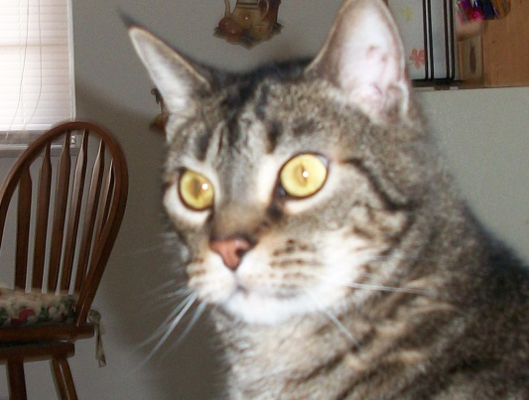
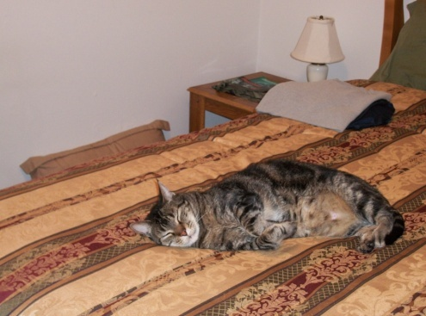
Acknowledgments
I wish to that the SIUE Anthropology Department, mostly for putting up with me.
I would like to thank Dr. Julie Holt, for listening to my rants and raves and then reading my papers.
Dr. Greg Vogel for teaching me how to use PhotoShop, and an atlatl, and for coining the term “patented madcap hijinks”.
Michele Lorenzini, for being cool and easy to talk to.
Dr. Jen Rehg, for being so patient with us loudmouths in the lab.
Dr. Aminata Cairo, for being a role model. I like to know there is someone out in the Anth world that looks like me.
Dr. Cory Wilmott, for being a tough teacher and scaring the bejesus out of me.
Dr. Nancy Lutz, for helping me to realize that Franz Boas is supercool.
I would like to thank all of my friends who are Anth students. It takes a special kind of crazy nut to be an Anth student, and I finally fit in somewhere. I would like to thank the Anthropology Club, because, once again, it takes a special kind of crazy.
Katie, Sarah, Elise, Grace, Jessica, Dan, Shannon, Steve, Tiff, Lexie, James- we’re gonna make it!
I would also like to thank my family, who have been here the entire time: My SuperHusband Alex, The World’s Greatest Mom-in-Law, and Pop.
And last but not least, I would like to thank Karl Cisneros, whose fuzz therapy helped me get through the hardest of research papers.

