Slide 1
Meta-Analysis of Native American Health and Pathology based upon Human Remains from Archaeological Sites in the American Bottom
by Amy Henson

Slide 2
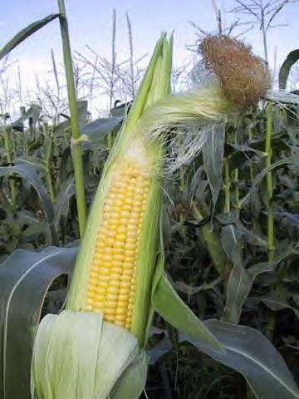
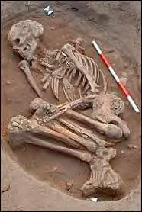
Background
13
Advent of Agriculture
Resulting changes:
Subsistence
Settlement Patterning
Social Stratification
Nutrition and Health
Use of Human Remains
14
Notes:
Agriculture arose as a subsistence strategy in the American Bottom—the floodplain of the Mississippi River in the Midwest and location of Cahokia Mounds, an archaeological “hot spot”—between the Archaic and Mississippian periods.
Without the diverse diet provided by hunting and foraging, nutritional intake was affected.
In addition, a turn toward more sedentary and nucleated settlements occurred, resulting in social changes and secondary health complications as infectious conditions emerged.
All of these factors can be seen through the study of human skeletal remains, shedding light on the health of past populations.

Slide 3
Objectives
Gather and evaluate archaeological site reports
Construct database of sites, human remains, demographic data and pathologies
Carry out analyses on database to:
Determine patterns and prevalence of pathologies
Evaluate differences in pathological patterns by age and sex
Evaluate differences in pathological patterns by cultural period
Notes:
By looking at human skeletal remains from the archaeological record as presented in archaeological site reports, I sought to examine patterns in health and skeletal pathology over the cultural periods that are widely acknowledged to coincide with the advent and proliferation of agriculture as the primary source of subsistence. I also sought to note how changes in health related to specific subgroups within populations, for example, males vs. females and old vs. young.
First, my intent was to gather archaeological site reports from sites between the Archaic and Mississippian periods in the American Bottom from which human remains had been excavated. I then compiled this data, including demographic data—such as age and sex—and pathological information into a database.
I then carried out analyses on this database to answer my research questions. Specifically, I sought to learn:
1. What patterns of pathologies are evident in the specimens and how prevalent are specific pathologies?
2. Are there differences in the patterns or prevalence of pathologies by age or sex?
3. Are there differences in patterns or prevalence of pathologies evident between populations that lived during the Archaic, Woodland, and Mississippian cultural periods—those periods most often associated with hunting-gathering, the rise of food production, and absolute reliance on agriculture as respective subsistence strategies?

Slide 4
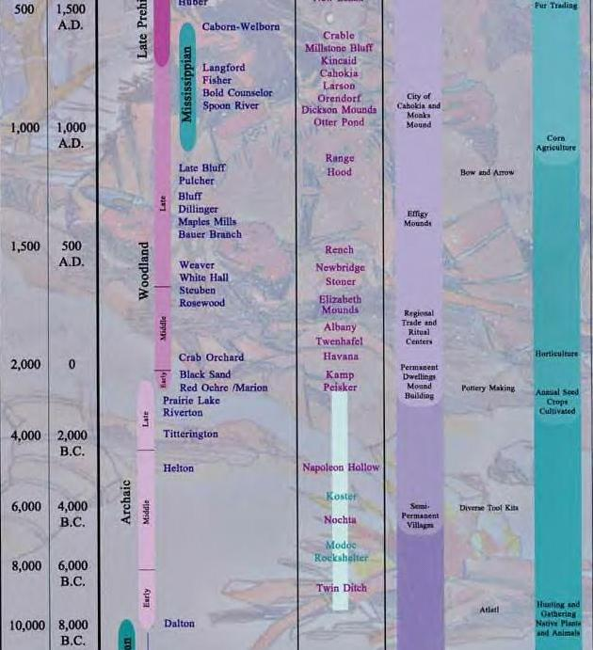
16
Notes:
This image is just to give a little chronological context to the periods that I addressed in this study.
*Point out the Archaic, Woodland, and Mississippian Period and the date ranges and ‘years ago’*

Slide 5
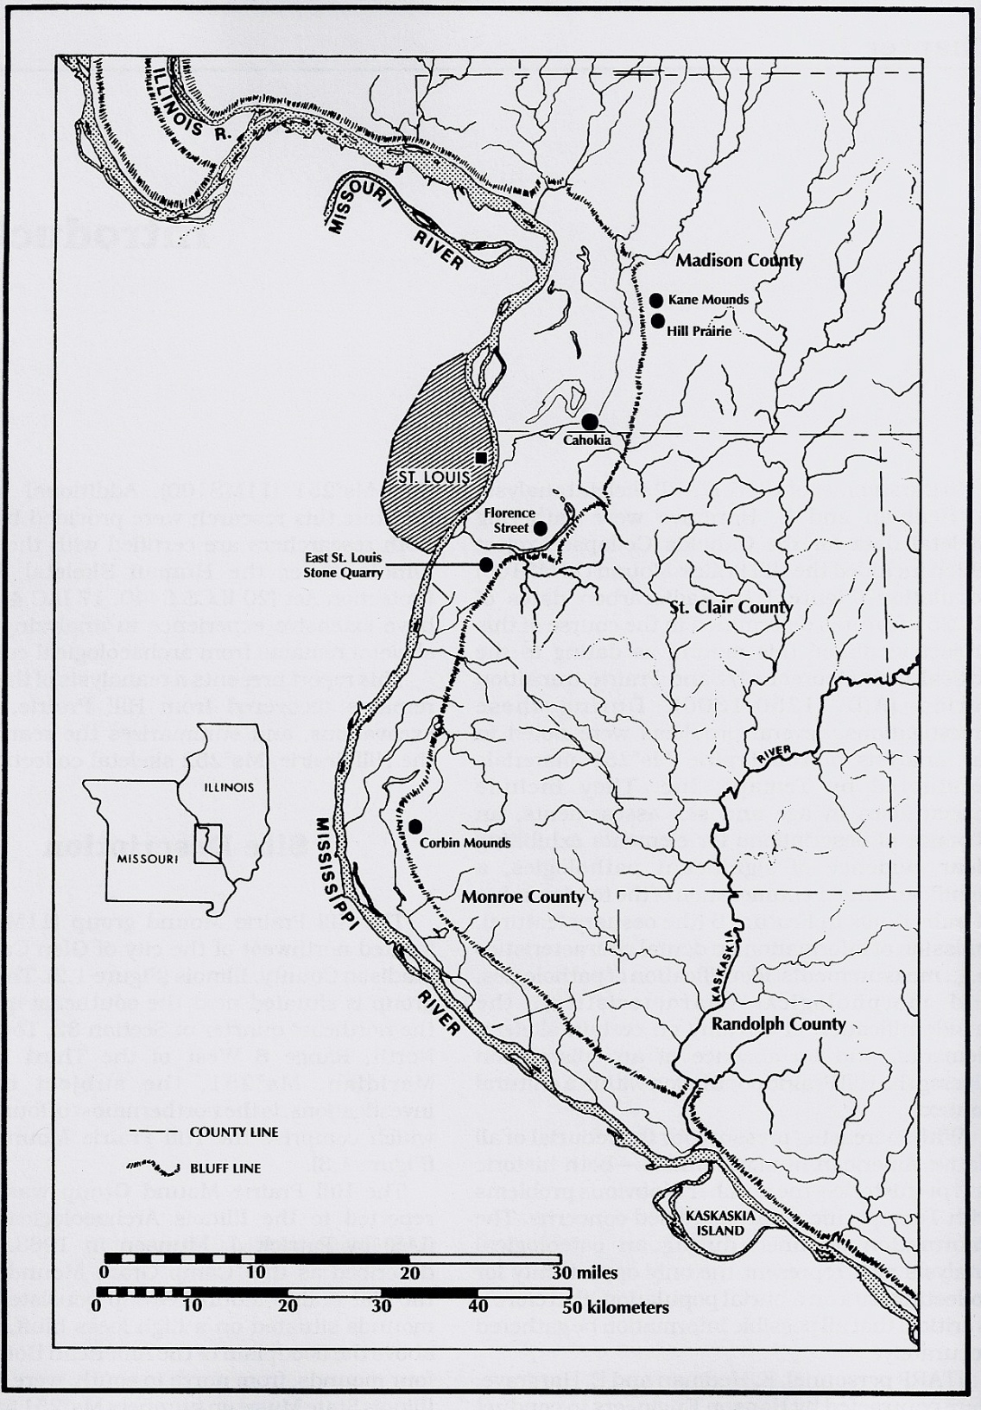
Sites and Samples
Modoc Rock Shelter
Dohack Site
Range Site
BBB Motor Site
Florence Street Site
Halliday Site
Mound 72, Cahokia
Radic site
Turner Site
Julien Site
Hill Prairie Mounds
East St. Louis Stone Quarry
15
Notes:
Here is a list of the sites that I included in my study. They range throughout the American Bottom, as you can see by the red dots, span from the Early Archaic to the Late Mississippian period, and have sample populations ranging from 2 individuals to 265 individuals. More detailed information can be provided regarding any of these sites after the presentation, if anyone would like more information.
STOP –NEXT SLIDE
-Modoc Rock Shelter (dot)– a hunting-gathering society, 29 individuals, ranging from early archaic to late archaic ~
roughly 7000 years, from 8000 BC to 1000 BC
-Dohack Site – 7 individuals, Woodland Period ~ approximately 1200 years, from 400 BC to 800 AC
-Range Site (dot)– 14 individuals, excavated from both Late Woodland and Early Mississippian periods ~
approximately 8500 years, from about 300 AC to 1150 AC
-BBB Motor Site – 12 individuals, Early Mississippian Periods ~ approximately 1500 years, from 1000 and 2500 AC
-Florence Street Site (dot) – 48 individuals, Early Mississippian
-Halliday Site – 32 individuals, Early Mississippian
-Mound 72, Cahokia (dot) – 265 individuals, Early Mississippian
-Radic Site – 14 individuals, Early Mississippian
-Turner Site – 2 individuals, Early Mississippian
-Julien Site – 2 individuals, Middle Mississippian Period ~ approximately 1000 years, from 1150 AC to 1250 AC
-Hill Prairie Mounds (dot) – 63 individuals, Middle Mississippian
-East St. Louis Stone Quarry Site (dot)– 120 individuals, Late Mississippian Period ~ approximately 1500 years,
from 1250 AC to 1400 AC

Slide 6
Data Collection & Construction
Notes:
In order to construct my database, I coded each for each site (CLICK) the variables and entered each individual into the database, repeating each individual if more than a single skeletal, dental or traumatic pathology was manifest.
I included the location of the (CLICK) archaeological feature from which the individual was excavated, (CLICK) the number or identification number of each individual as assigned by the researchers, and the (CLICK) cultural period associated with the site.

Slide 7
Data Collection & Construction
Notes:
I also coded the sex and (CLICK) age of each individual, as well as the pathological condition. More information regarding the database and its construction if you have questions after the presentation.

Slide 8
Results
Notes:
In addressing my first question regarding the presence and prevalence of pathological patterns, I categorized the pathologies that I encountered in the site reports into four categories—the green-boxed pathologies indicate dental pathologies:
There are:
Degenerative pathologies, such as arthritis or osteoporosis, tend to indicate older age or rougher wear on the skeleton prior to death, or may have been due to trauma or injury.
Nutrition-related pathologies indicate the diet of a population is lacking in nutrients.
Infection-related pathologies, which may have a number of possible causes. They are sometimes indirectly associated with agriculturalist populations as infections increase with the development of settled societies.
Those pathologies in the miscellaneous category include pathologies related to cultural modifications or pathologies that do not fit into the three previous categories.
Arthritis was most common pathology overall, occurring in 24% of the entire regional sample. Linear enamel hypoplasias and dental attrition were the most common dental pathologies, each occurring in over 15% of the regional sample.

Slide 9
Results
Notes:
Only 157 remains from eight sites had been fully reported upon by researchers in regards to pathologies. Seventy remains showed evidence of skeletal pathologies, while sixty-two showed evidence of dental pathologies
This table shows the number of individuals with pathologies, adjusting for those individuals that may have been repeated in the database due to multiple pathologies—as you can see, there is quite a difference in the sample size from different sites.
Of the 157 remains that were included in this study and accompanied by information from the researchers, there were 131 manifestations of skeletal pathologies and 133 manifestations of dental pathologies.

Slide 10
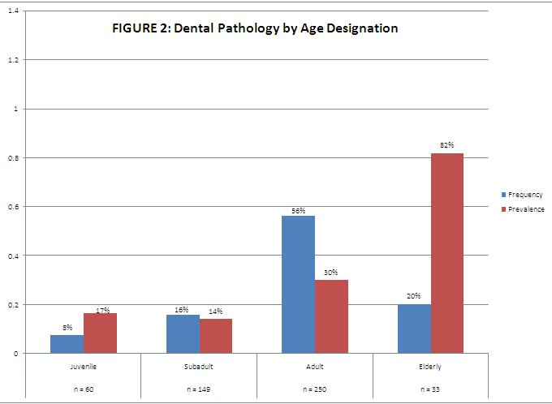
Results
Notes:
For this chart—and all that follow—I’m going to explain a few things. First, x, or horizontal axis, represents the subgroup—such as age or pathology—that I will be evaluating. The y, or vertical axis, represents the proportion or percentage signified by the columns in the chart. All blue columns denote “frequency”—the number of cases of a particular pathology found in the entire sample. The red columns denote the “prevalence”—which I define as the ratio of a particular pathology to the number of individuals in a particular subgroup. For example, here, in the elderly subgroup, there are 33 individuals represented. The blue column shows that 29% of all pathologies are found in elderly individuals. The red column—which shows 115%—shows that some elderly individuals had more than one pathological condition—the number of pathologies in the elderly subgroup exceeds the number of individuals in that subgroup.
This first chart shows that skeletal pathologies were more frequent—as shown by the blue column—in the adult age range. 49% percent of all skeletal pathologies and were found in adults, however there is a greater number of adults in the regional sample than any other age subgroup. When adjusted for sample size, skeletal pathologies were most prevalent—as shown by the red columns—in those remains belonging to the elderly age range.
(CLICK) The same pattern is followed in dental pathologies, with a higher frequency in the adult range, but a higher prevalency in the elderly age range.
I carried out the same analyses for sex, however for this presentation, I am focusing on the results found in the age subgroup. Any questions regarding the results for sex can answered after the presentation.

Slide 11
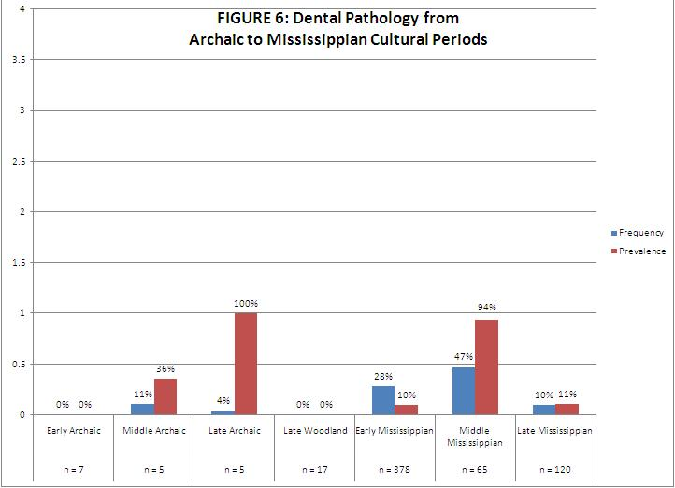
Results
Notes:
Both skeletal and dental pathologies were more frequent in the Mississippian period, followed by the Archaic period, with the least pathologies observed in the Woodland period. However, the highest prevalence of both skeletal and dental pathologies occurs in the Archaic period followed by the Mississippian period—as you can see here with the chart showing skeletal pathologies by Cultural period. (CLICK) Here the chart showing dental pathologies by cultural periods follows the same pattern. These results may be due to the extreme lack of information provided by the researchers for the Mississippian samples.
Questions regarding more detailed results overall and for each site can be provided after the presentation for those interested.

Slide 12
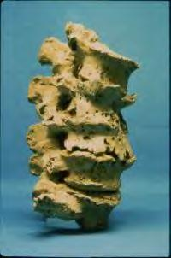
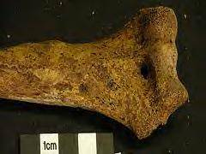
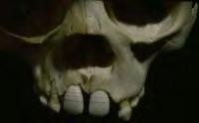
Discussion: Patterns and Prevalence
17
Degenerative pathologies most common
Skeletal Pathologies:
Infection-related more common
Dental Pathologies:
Nutrition-related more common
18
19
Notes:
Degenerative pathologies were the most common, with arthritis being the most frequent, overall. This photo shows arthritic lipping of the vertebral column.
Next, infection-related skeletal pathologies were more common than nutrition-related skeletal pathologies. This photo is an example of treponemal infection on a humerus—a bone of the lower arm.
In contrast to skeletal pathologies, nutrition-related dental pathologies were more common than infection-related dental pathologies. This photo shows linear enamel hypoplasias in a juvenile—evidence of multiple episodes of nutritional distress.

Slide 13
Discussion: Pathology by Age
Skeletal Pathologies
Degenerative most common, except neonates and infants
Nutrition-related most common in neonates and infants
Dental Pathologies
Nutrition-related most common, overall
Notes:
Evaluating by Age, degenerative skeletal pathologies were more prevalent than other skeletal pathologies in all age subgroups except neonates and infants, in which nutrition-related skeletal pathologies were more prevalent. This was very surprising, and could have at least two alternative meanings. First, it could mean that the nutrition received in utero and while nursing and weaning was insufficient to sustain these children. However, it could also mean that only the sickest individuals were dying—their ill health exacerbated by poor nutrition, and that the healthy were surviving similar conditions.
Also, nutrition-related dental pathologies were more prevalent than all other dental pathologies in all age subgroups.

Slide 14
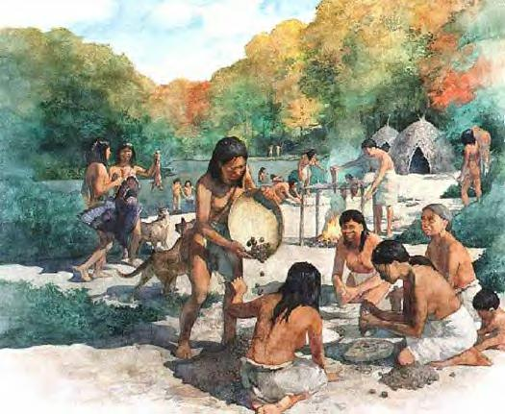
Discussion: Pathology by Period
Unusual findings in the Archaic
Evidence of better health?
Notes:
My findings showed that all pathologies—relative to the sample sizes of each site—were more prevalent in the Archaic period. This was extremely unexpected, as pathologies were expected to increase with the introduction and proliferation of agriculture.
However, there were no nutrition-related skeletal pathologies in the Archaic sample. Therefore, it might seem that the appearance of agriculture did have an impact on health, possibly decreasing the physical stress endured by individuals, at the cost of richer-nutrient foods.

Slide 15
Significance
Limitations
Small Sample Sizes
Lack of newer methods
Incomplete Site Reports
Contribution
Preliminary study
Template
Suggestions
Standard for Site Reports
Further Research
Notes:
It is absolutely critical for me to note, however, several factors that influence this data. First, the sample sizes of my study—both overall at 608 individuals, and from particular sites and periods—may not provide an adequately representative sample. For example, Modoc Rock Shelter is the only Archaic site from my regional sample, comprised of 29 individuals—a fact that could weight the importance of pathologies at this site when evaluating pathologies by period.
Second, my data relied entirely on osteological information provided in archaeological site reports, not taking into account new information such as isotopic or biochemical analysis that could provide more conclusive evidence as to the status of health and nutrition in a given population or individual.
Finally, and most importantly, my sites from the with the largest sample populations have very little or no information regarding the pathologies found in the sample. It is difficult to compile data, and nearly impossible to draw reliable conclusion without having complete documentation. For example, of the 265 individuals excavated from Mound 72, only 2 individuals were reported upon in the site report.
This study is an excellent preliminary study with unusual and unexpected results, emphasizing the need for further in-depth study in this topic and perhaps providing a template for such future research.
My suggestions include, most importantly, a standard for the reporting of human remains in archaeological site reports, or adherence to standards already set in place. In addition, further research on this topic, including larger sample sizes, possibly increasing the temporal and spatial range for a better representative sample.

Slide 16
Acknowledgements
Dr. Rehg, for her infinite patience, encouragement, and advice throughout this study and the past four years.
Mike and Lisa Henson, for their patience, assistance, and encouragement through the long hours of research and data entry.

Slide 17
References
Ambrose SH, Buikstra J, Kreuger HW. 2003. Status and gender difference in diet at Mound 72, Cahokia, revealed by isotopic analysis of bone. Journal of Anthropological Archaeology 22: 217-226.
Armelagos GJ. 1990. “Health and Disease in Prehistoric Populations in Transition.” In: Swedlund AC, Armelagos GJ, editors. Disease in Populations in Transition. p 127-144.
Armelagos GJ, Brown PJ, Turner B. 2005. Evolutionary, historical and political economic perspectives on health and disease. Social Science and Medicine 61: 755-765.
Cook, DC. 1984. “Subsistence and Health in the Lower Illinois Valley: Osteological Evidence.” In: Cohen MN, Armelagos GJ, editors. Paleopathology at the Origins of Culture. p 235-269.
Hedman KM. 2006. Late Cahokian subsistence and health: stable isotope and dental evidence. Southeastern Archaeology 25(2): 258-274.
Milner GR. 1992. “Morbidity, Mortality, and the Adaptive Success of an Oneota Population from West-Central Illinois.” In: Woods W.I., editor. Late Prehistoric Agriculture: Observations from the Midwest. p 136-166.
Goodman AH, Martin DL. 2002. “Reconstructing Health Profiles from Skeletal Remains.” In: Steckel RH, Rose JC, editors. p 11-60.
Yerkes RW. 2005. Bone Chemistry, Body Parts, and Growth Marks: Evaluating Ohio Hopewell and Cahokia Mississippian Seasonality, Subsistence, Ritual, and Feasting. American Antiquity 70(2): 241-265.
Danforth ME. 1999. Nutrition and Politics in Prehistory. Annual Review of Anthropology 28: 1-25.
Kelly JE. 1992. “The Impact of Maize on the Development of Nucleated Settlements: An American Bottom Example.” In: Woods W.I., editor. Late Prehistoric Agriculture: Observations from the Midwest. p 167-197.
Ramenofsky AF, Wilbur AK, Stone AC. 2003. Native American disease history: past, present and future directions. World Archaeology 35(2): 241-257.
Lewis M, Roberts C. 1997. Growing Pains: the Interpretation of Stress Indicators. International Journal of Osteoarchaeology 7: 581-586.
“Mayan Maize.” Photograph. From Mayan Riviera: Try Mayan Food in the Riviera Maya. http://www.rivieramaya.info/news/uploaded_images/mayan-maize-790916-790993.bmp .
“Bioarch.Skel.” Photograph. From Bioarchaeology. http://www.dur.ac.uk/archaeology/research/groupings/bioarchaeology.
Hedman K, Hargrave EA. 1999. Hill Prairie Mounds: The Osteology of a Late Middle Mississippian Mortuary Population. Transportation Archaeological Research Reports. no 6.
“A Culture Sequence and Chronology of Illinois.” Photograph. From Illinois Archaeological Survey: Resources for Educators. http://virtual.parkland.edu/IAS/resources_for_educators/timeline8x10c.jpg.
“Marginal lipping, representing osteoarthritis.” Clark Spencer Larsen. Photograph. From Post-Pleistocene Human Evolution: Bioarchaeology of the Agricultural Transition. http://cast.uark.edu/local/icaes/conferences/wburg/posters/cslarsen/larsen.html..
“Treponematosis.” Mike Henderson. Photograph. From The working life of Museum of London. http://www.mymuseumoflondon.org.uk/blogs/blog/category/centre-for-human-bioarchaeology/page/2/.
“Hypoplasia in a juvenile.” Clark Spencer Larsen. 1998. From Post-Pleistocene Human Evolution: Bioarchaeology of the Agricultural Transition. http://cast.uark.edu/local/icaes/conferences/wburg/posters/cslarsen/larsen.html..
“Archaic Period.” Greg Harlin. From Archaeology and the Native Peoples of Tennessee. http://mcclungmuseum.utk.edu/permanent/native/archaic.shtml.

